Slide 1

HRIS SuccessFactors 2026 Performance Management Experience

Slide 2
2026 Performance Management Requirements
HRIS
REMOVED | ADDED/UPDATED
Individual objective weights and weighted ratings | Rating scale updated to 1-4 points with new labels
Individual objective rating selection (Teammate & Leader) | Team Ranker
Calculated Rating | Revised Ask for Feedback template
Leadership Competency sections (Teammate & Leader)
Gap Analysis (no longer necessary due to individual ratings removed)
Manager individual objective comment box cannot be removed due to system limitation.
FOOT LOCKER, INC.

Slide 3
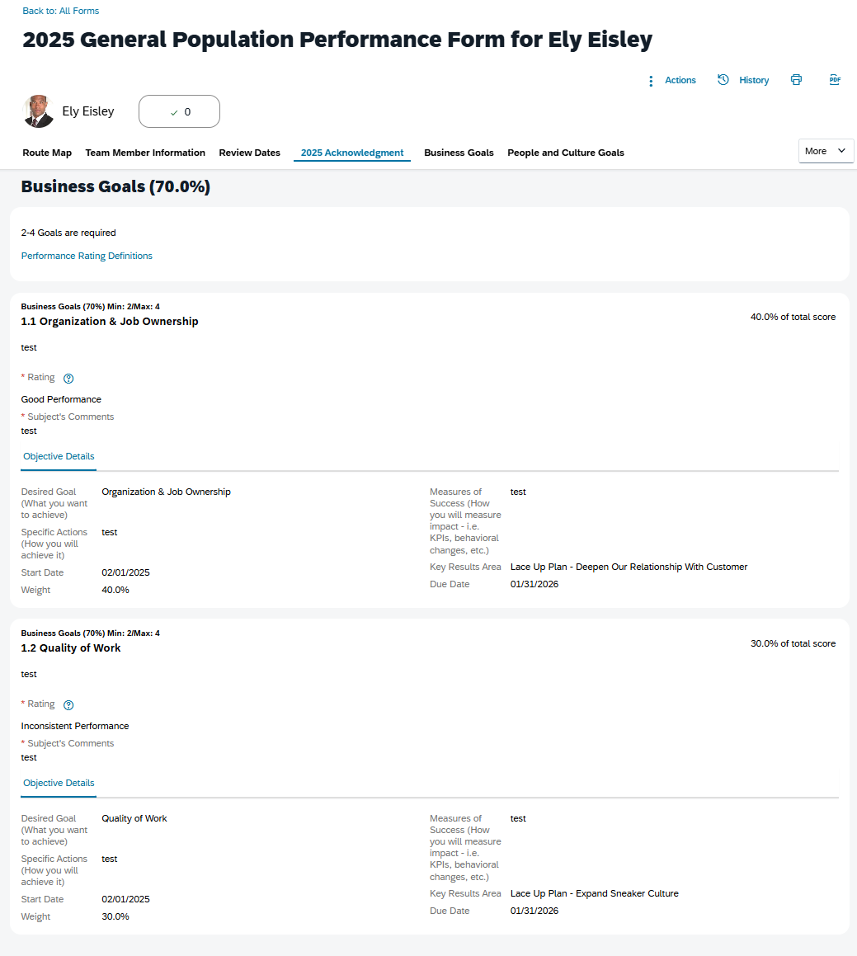
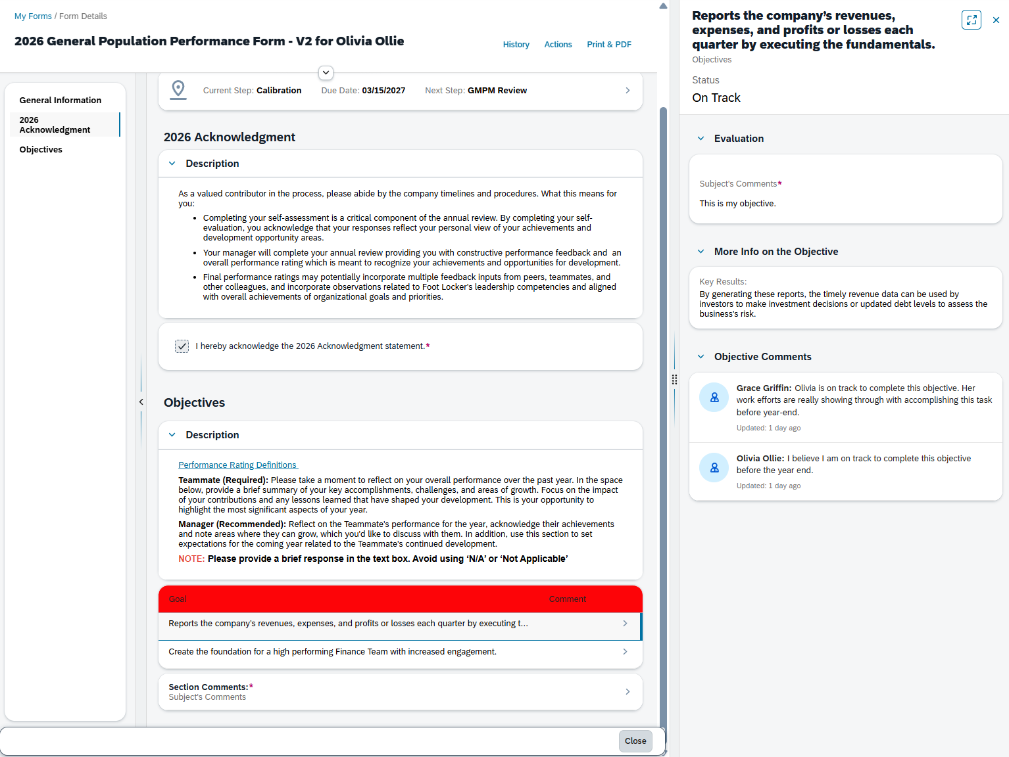
Legacy Performance Management VS Latest Performance Experience
HRIS
Legacy
Latest

